Slide 1
Digital Signal Processing(BEC-303)
Unit-1
Lecture-9
Presented By:
Dr. Ishwar Chandra Yadav

Slide 2
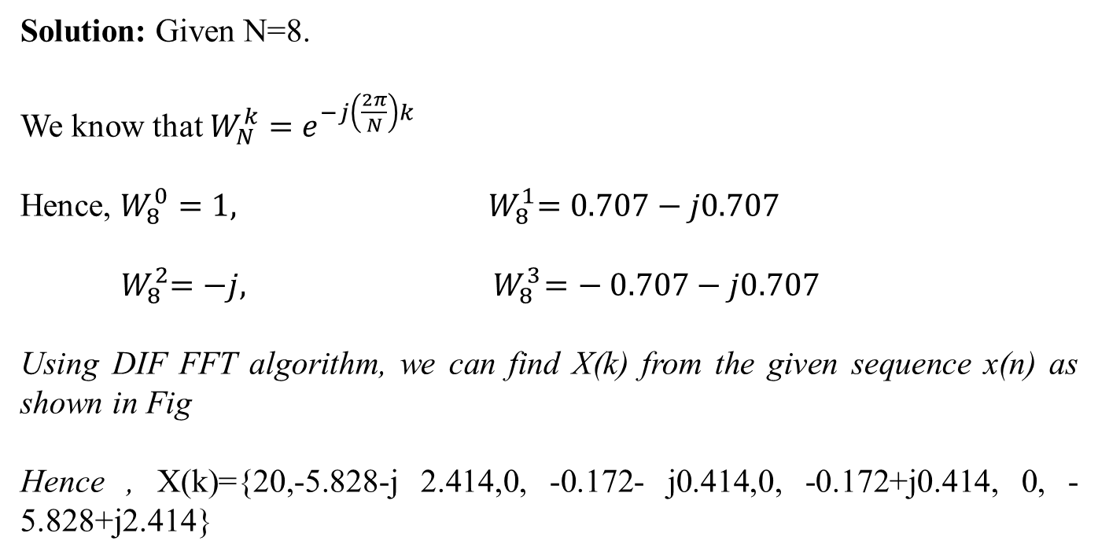
Example : Given x(n)={1,2,3,4,4,3,2,1}, find X(k) using DIF FFT algorithm.
Solution: Given N=8.
We know that $W_{N}^{k}=e^{−j\left(\frac{2π}{N}\right)k}$
Hence, $W_{8}^{0}=1,$ ${ W}_{8}^{1}=0.707−j0.707$
$${ W}_{8}^{2}=−j,{ W}_{8}^{3}=− 0.707−j0.707$$
Using DIF FFT algorithm, we can find X(k) from the given sequence x(n) as shown in Fig
Hence , X(k)={20,-5.828-j 2.414,0, -0.172- j0.414,0, -0.172+j0.414, 0, -5.828+j2.414}

Slide 3
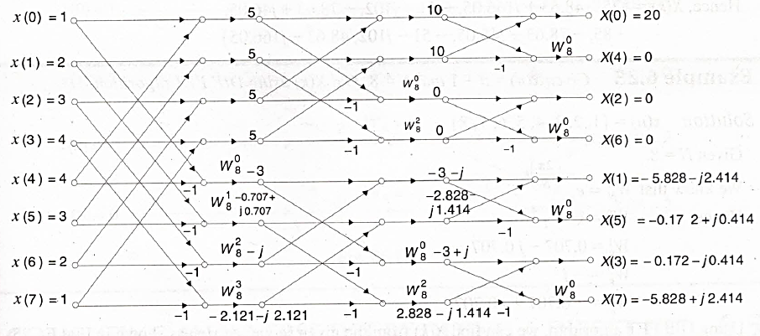
Fig :X(k) from the given sequence x(n)

Slide 4
Extension to General Intervals of Definition
Take the case of a sequence defined on a different interval:
How do we compute the DFT, without reinventing a new formula?

Slide 5
First see the periodic extension, which looks like this:
Then look at the period

Slide 6
Example: determine the DFT of the finite sequence
Then take the DFT of the vector

